Slide 1


Students Result Analysis using Python
By –Vishakha jaiswal

Slide 2
Overview
The analysis of students' results aims to uncover key patterns and insights that can influence educational outcomes. By studying factors such as gender distribution, parental education, and marital status, this analysis provides valuable insights into how different variables impact student performance. Understanding these relationships can help in designing better educational strategies and policies.

Slide 3
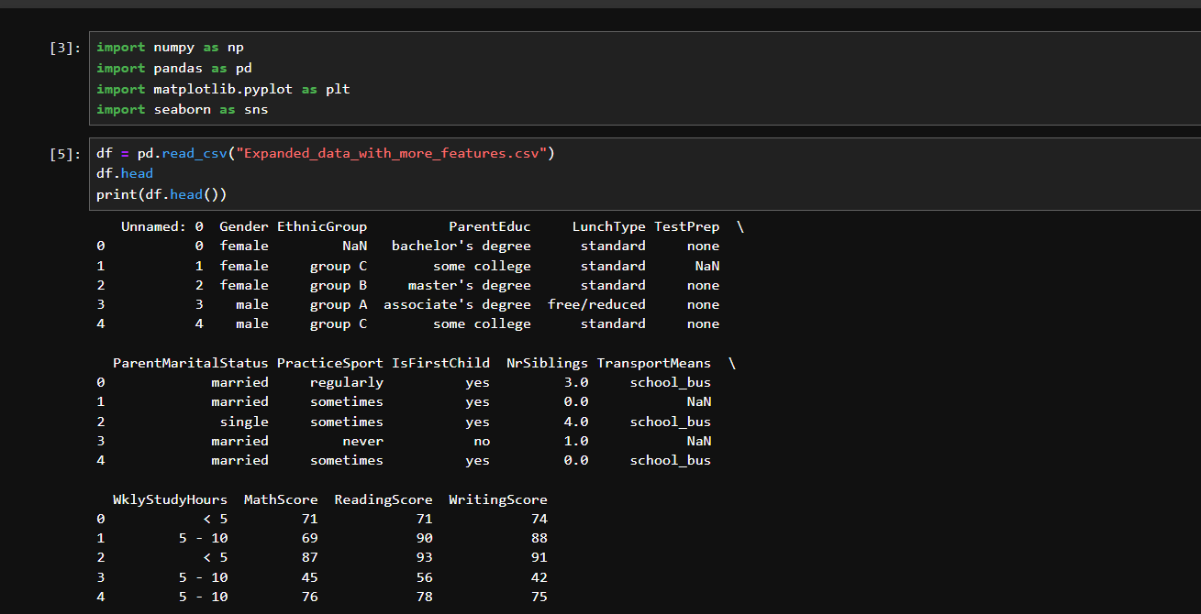

Slide 4
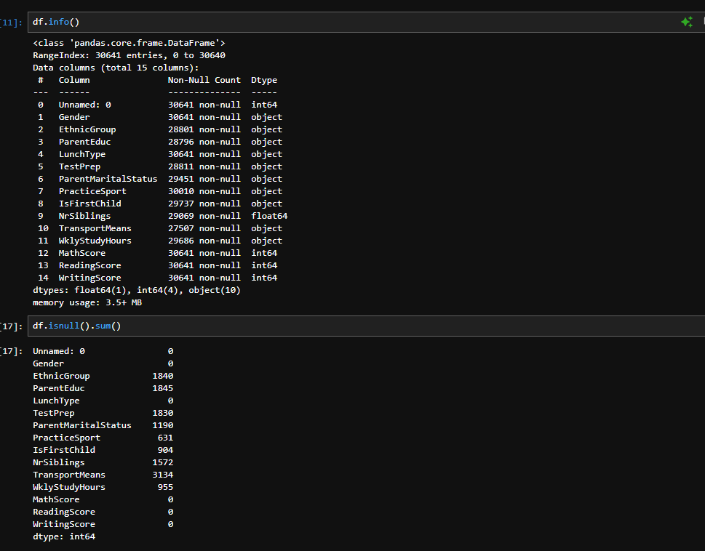

Slide 5
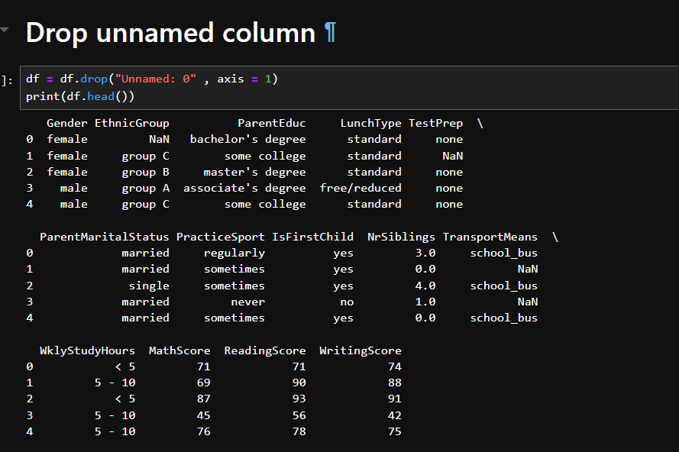

Slide 6
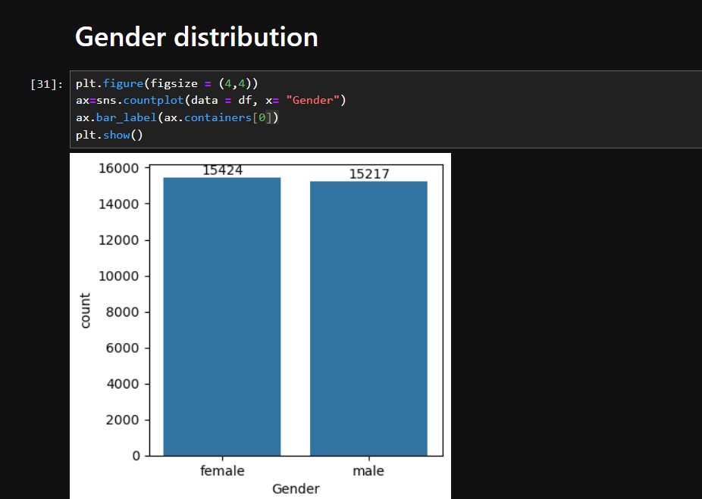
Insight : from the above chart we have analysed that:
the number of females in the data is more than the number of males

Slide 7
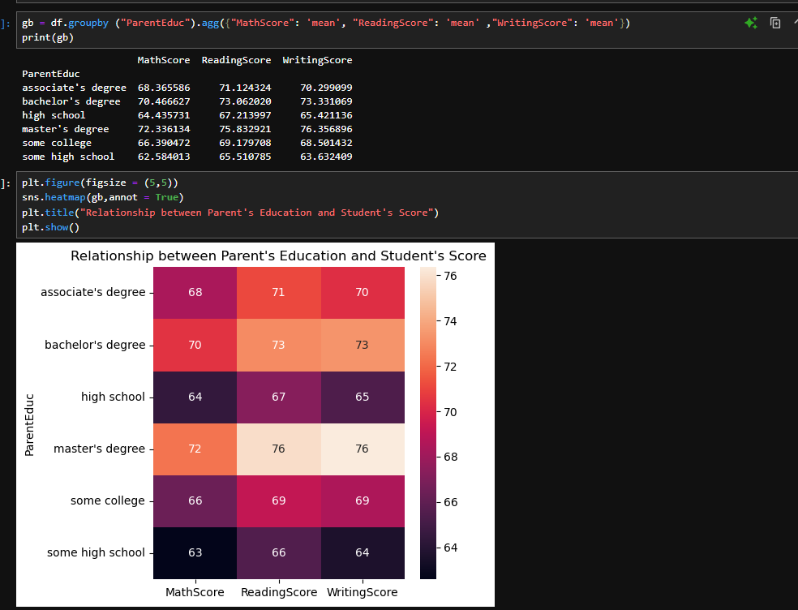
Impact of Parental Education
Insight: from the above charts we have conclude that: the education of the parents have a good impact on their studenst

Slide 8
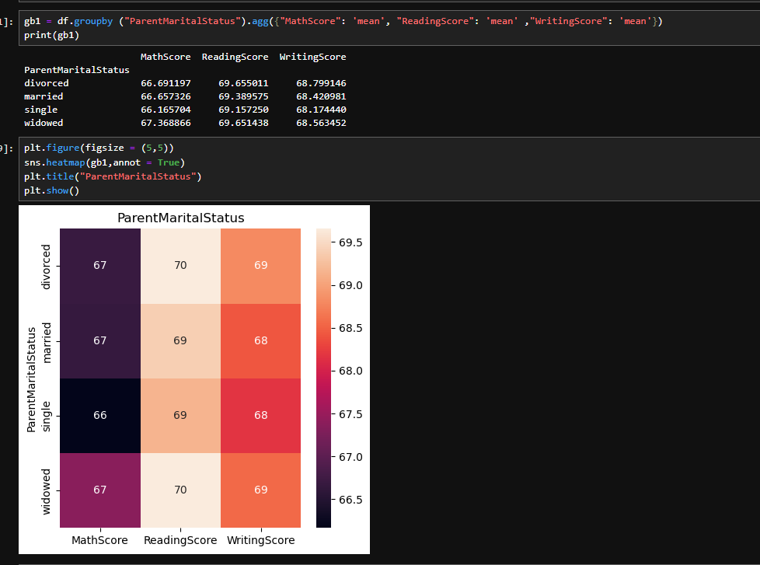
Parental Marital Status
Insight: from the above charts we have conclude that:
the ParentMateritalstatus of the parents have a not impact on their studenst

Slide 9
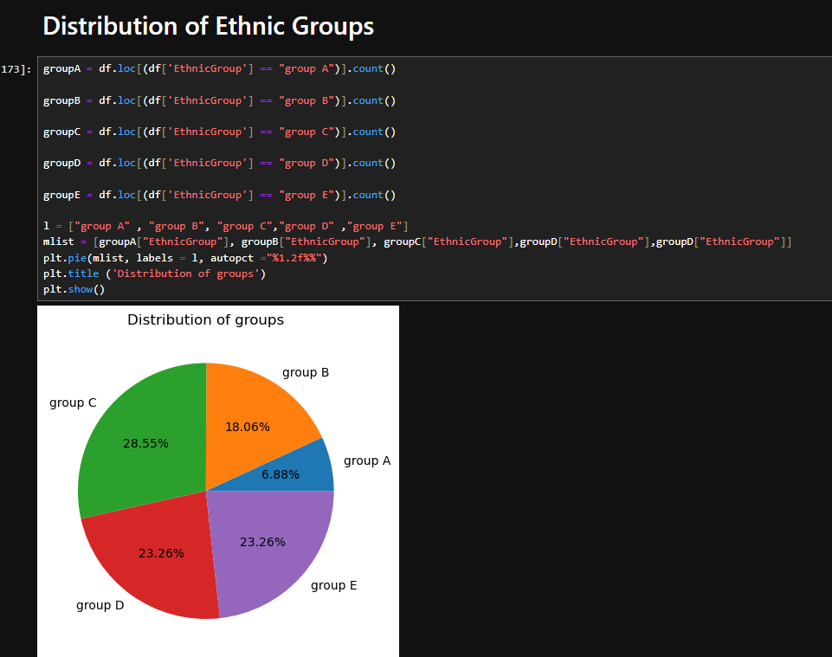

Slide 10
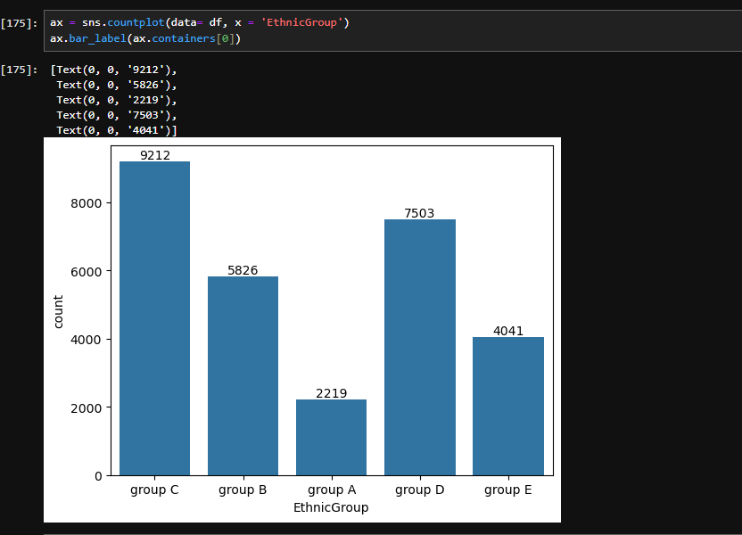

Slide 11
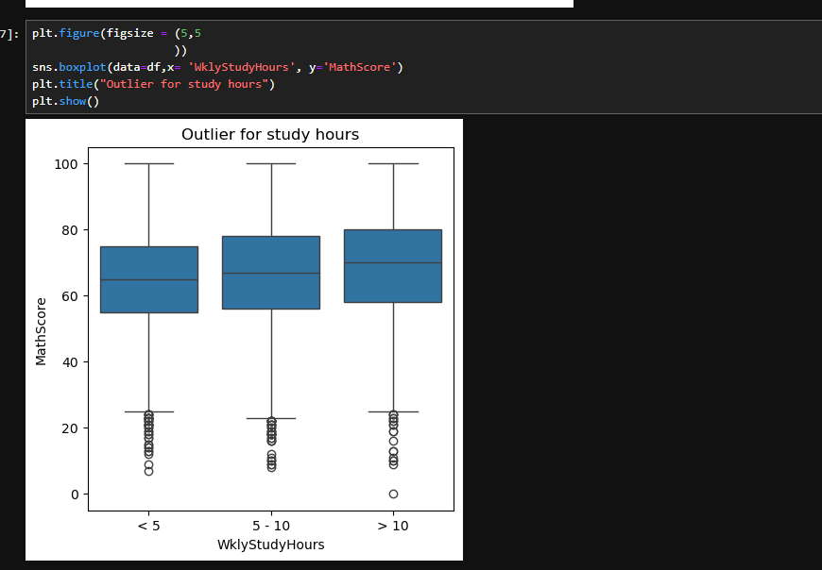
Weekly Study Hours and Performance
Insight: Students with consistent study hours tend to perform better, but outliers exist.

